Slide 1
VINELink Experience
VINE features for victims and survivors of crime.

Slide 2
How are you currently using New Mexico VINE?

Slide 3
What is VINE?
Provides timely offender custody information to victims of crime and concerned citizens
Free service accessible by phone, website, and mobile app
User notifications by phone, email, or text

Slide 4
What is VINE?
What is New Mexico VINE?
New Mexico VINE/VINELink Key Benefits
Tour of New Mexico VINELink

Slide 5
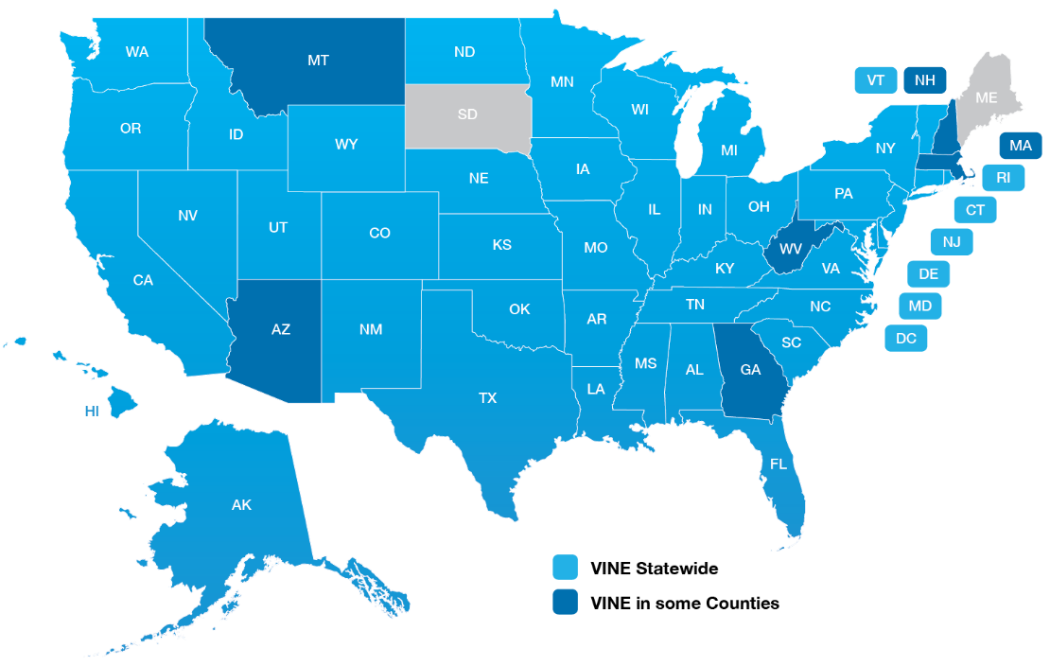
VINE Across the Nation
48
STATES
43
DEPTS. OF CORRECTIONS

Slide 6
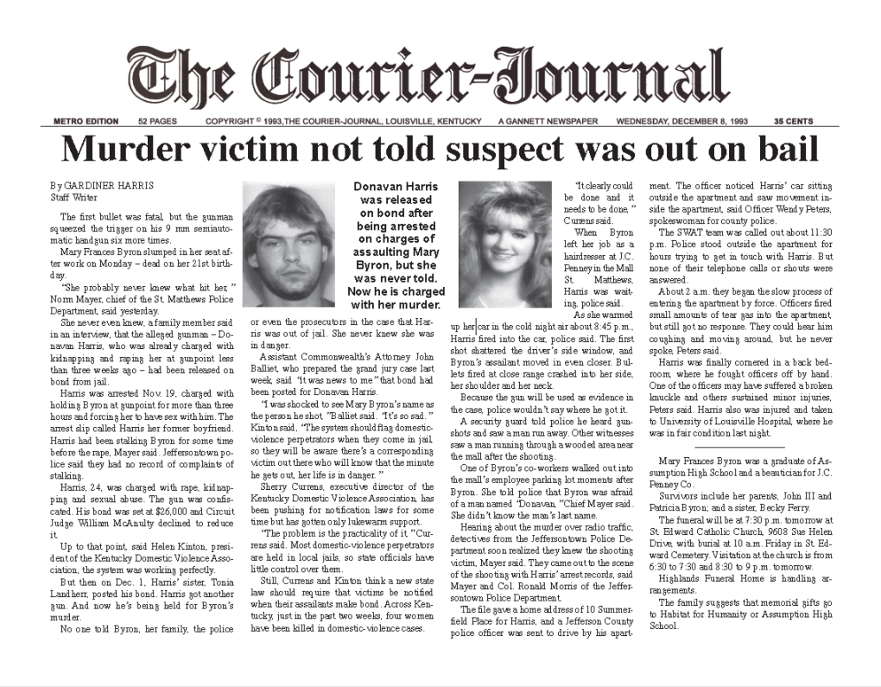
The nation’s first automated victim notification program

Slide 7
Beneficial Resource New Mexico Enhanced VINE
Victims
Safety
Law Enforcement & Criminal Justice Personnel
Safety
Service Providers
Safety
Public
Safety
Information
Information
Peace of Mind
Knowledge
Planning
Empowerment
Information
Investigation
Tracking
Good Public Relations
Information
Time Savings
Knowledge
Good Public Relations

Slide 8
Reaching more victims with New Mexico VINE
Crime victims have a vast amount of resources at their disposal, such as safety services, professional therapy, and criminal justice advocacy, however…
There is currently no national website or mobile app
that promotes victim self-advocacy.
Local resources are often challenging for victims to access.

Slide 9
VINE Workflow
1
2
3
4
5
Booking occurs
Victim accesses VINE
Victim registers
Custody status updated
Notification sent
VINE automatically receives booking, arrest, and crime data.
Anonymously check an inmate’s custody status through:
Toll-free number
www.VINELink.com
VINELink app
Receive automated custody status change notification via:
Phone
Email
Text
TTY
In-App
Jail/prison updates offender custody status.
Examples include: release, escape, and death.
Notification is immediately sent to all registrants. For Phone Notifications, a PIN code is required to confirm the notification.

Slide 10
Victims
Find an Offender
Edit Registration
State Resources
Link registrations based on (offender) person match
Last and First Name
Date of Birth
Offender ID#
VINELink account – edit or disable existing registration
Learn more about the resources and the information your state provides.

Slide 11
Law Enforcement
Arrest
Safety Resource
Booking
Automated Information
Custody Status
Accurate & Timely
24/7 Access
Good Public Relations

Slide 12
Access Offender Custody Status Information
New Mexico VINE by PHONE
(877-551-8463)
VINELink APP
ONLINE
www.VINELink.com

Slide 13
Learn more about Enhanced VINE and VINELink
Upcoming Webinars:
VINELink
Awareness Training
Coming Soon!
VINELink Video Tutorials &
Training Resources:
VINELink Help

Slide 14
New Mexico VINE Program Administrators
Julie Rivera
VINE-Victim Liaison / Victim Advocate
NM Crime Victims Reparation Commission
6200 Uptown Blvd. Suite 210
Albuquerque, New Mexico 87110
505-946-8975
Fax 505-841-9437
Julieanna.rivera@state.nm.us
Local & Regional Jail and DOC Inquiries
1-877-842-8464
cdvictimsrvs@state.nm.us

