Slide 1

New Mexico
Crime Victims Reparation Commission

Slide 2
The NM Crime Victims Reparation Commission(CVRC) assists victims of violent crime with expenses incurred as a result of their victimization.
We also administer federal and state funding to organizations that provide victim services statewide.

Slide 3
Compensation Funding
State
Federal
Inmate Wages/Restitution

Slide 4
Compensation
Victim of Violent Crime
Occurred in New Mexico
Reported to Law Enforcement, Licensed Medical, Mental or Tribal Health Provider
2 Years to Apply or Good Cause

Slide 5
Frequently Asked Questions
Undocumented Individuals
NM Resident (Out-of-State or Out of the Country)
Victimization In Custody is Ineligible

Slide 6
Determining Eligibility

Slide 7
Collateral Sources
  Donations/Crowd Funding
Causal Behavior
  Contributory Behavior
Ineligible Expenses
  Property

Slide 8
Crimes Enumerated
(Eligible crimes)

Slide 9
Abuse or Abandonment of a child
Aggravated indecent exposure
Arson resulting in bodily injury
Aggravated assault; Aggravated battery
Assault against a household member
Battery against a household member
Criminal sexual penetration
Criminal sexual contact of a minor
Dangerous use of explosives resulting in bodily injury

Slide 10
Failure to Give Information & Render Aid
Homicide/Great Bodily Injury by vehicle
Human trafficking
Involuntary manslaughter
Kidnapping
Negligent use of a deadly weapon
Murder
Stalking
Voluntary manslaughter

Slide 11
Up to $20,000.00

Slide 12
$30,000.00
Catastrophic Injury/Permanent & Total Disability

Slide 13
Eligible Expenses
Funeral (Priority Processing)
Loss of Wages
Medical
Counseling
Relocation & Rent
  (Domestic Violence, Sexual Assault, Human Trafficking)
Other Related Expenses
*Some expenses have financial thresholds.

Slide 14
Reimbursement

Slide 15
100%
VICTIM

Slide 16
65%
Provider

Slide 17
FUNDING OPTIONS
Victim Compensation
Emergency Assistance Funds (EAF)
Human Trafficking Crisis Stabilization
Sexual Assault Emergency Funding
  NM Coalition of Sexual Assault Programs
Missing Persons Funding
  Coalition to Stop Violence Against Native Women

Slide 18
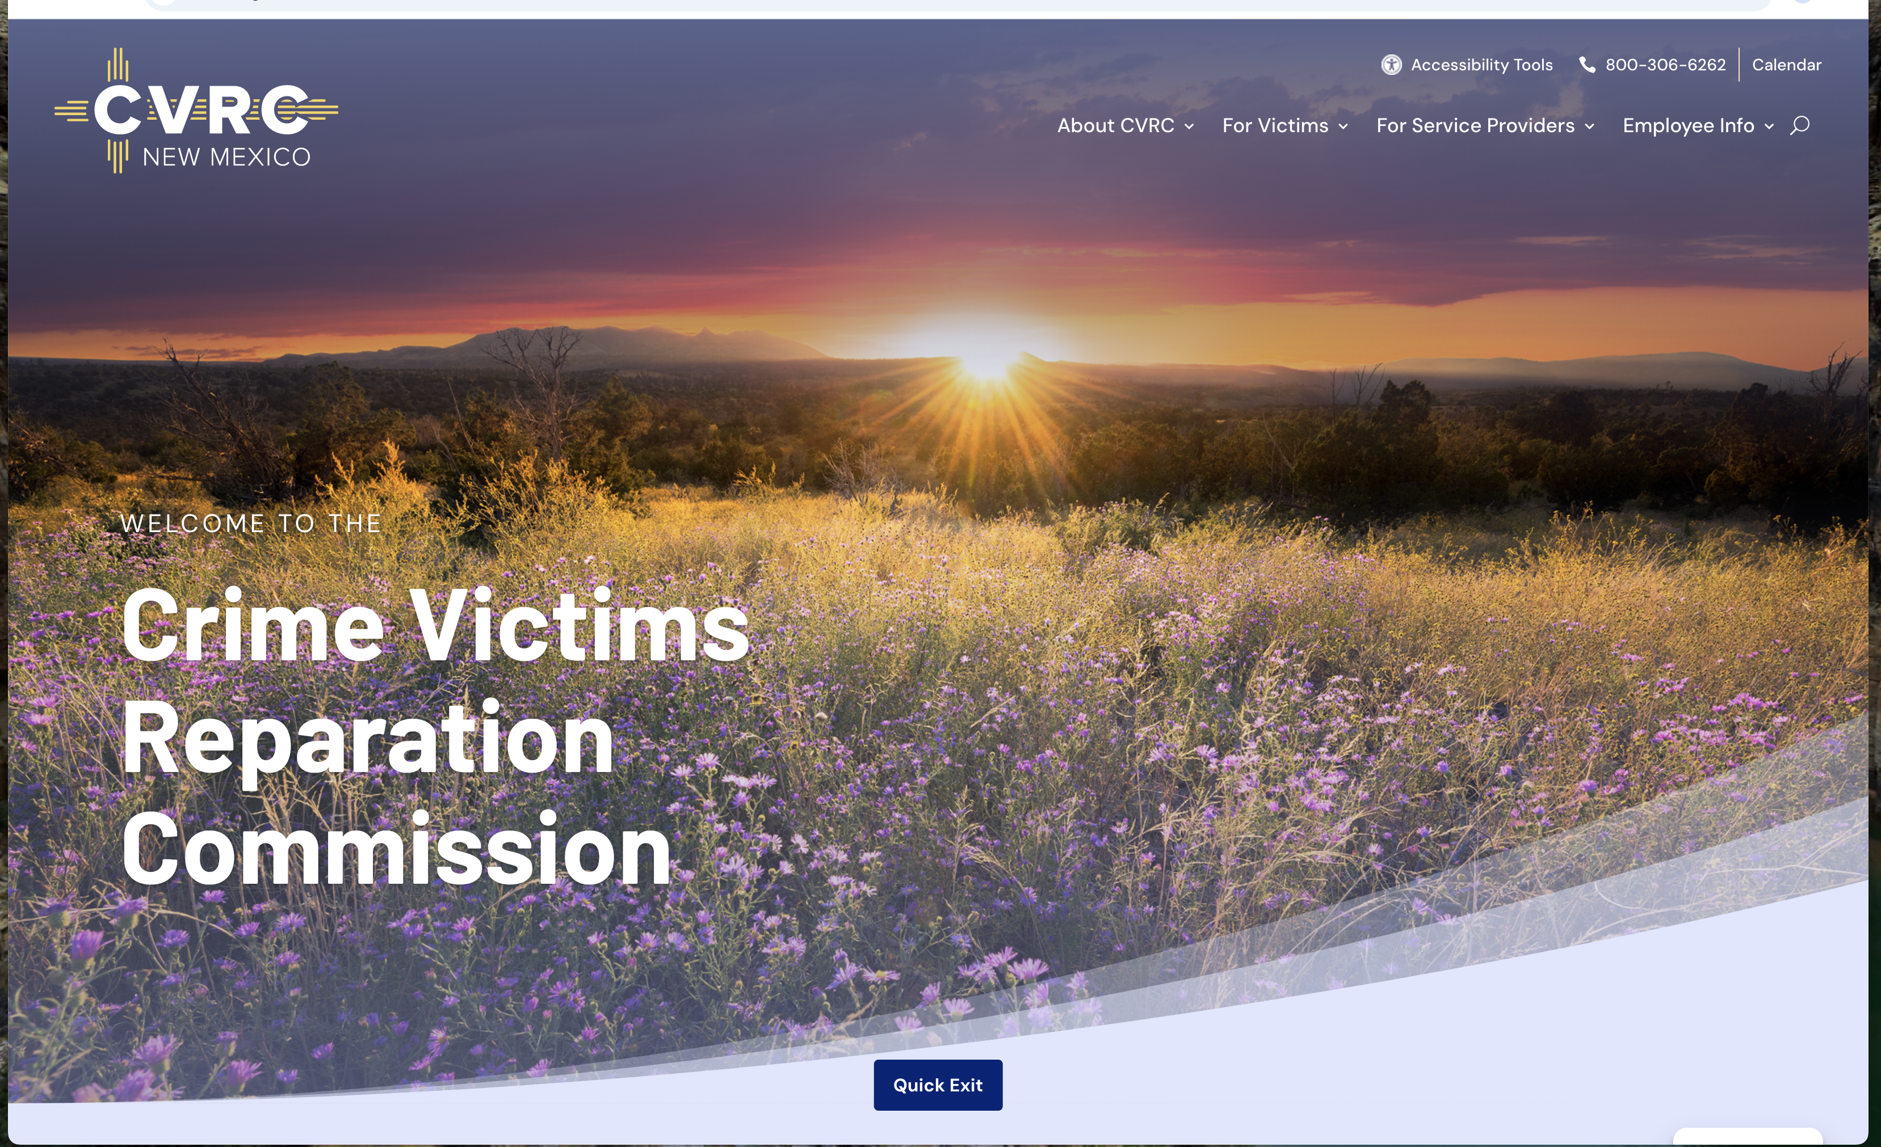

Slide 19
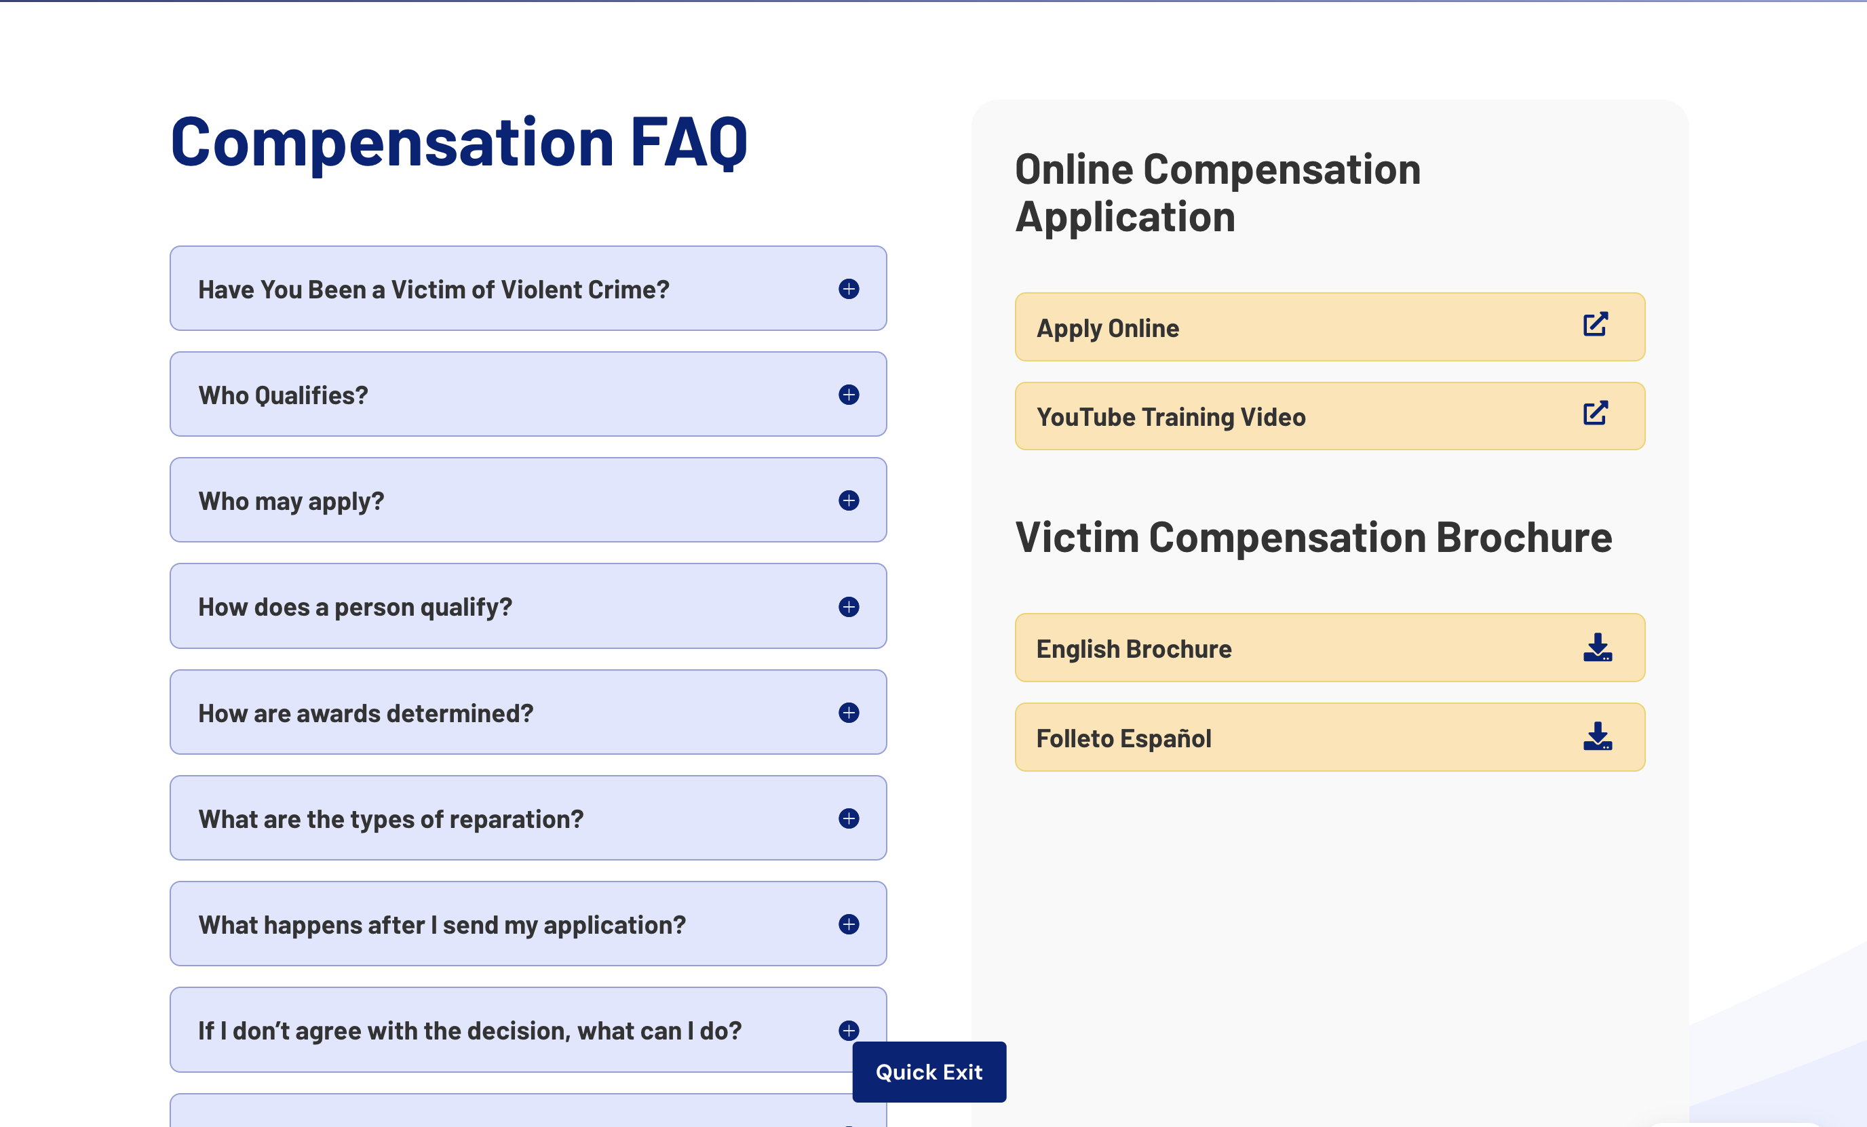

Slide 20
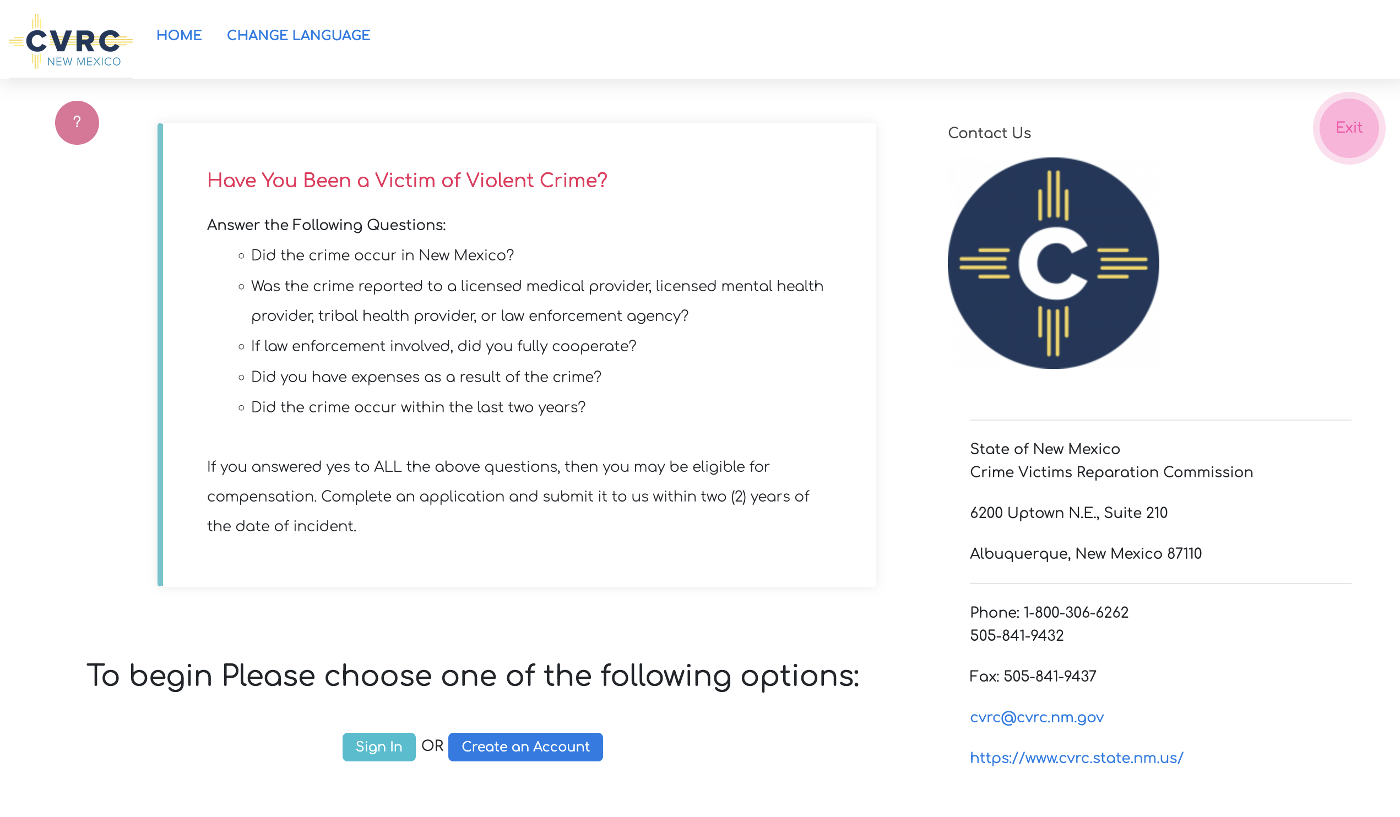
CCVCNM.ORG

Slide 21
QUESTIONS?

Slide 22
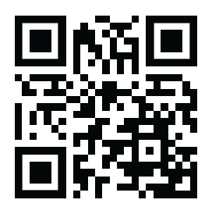
www.cvrc.state.nm.us
505-841-9432
Thank you!

