Slide 1
New Mexico Crime Victims Reparation Commission

Slide 2
Who is CVRC?
The Crime Victims Reparation Commission (CVRC) assists victims of violent crime with expenses incurred as a result of their victimization.
CVRC also administers funding to organizations to provide victim services statewide.

Slide 3
Purpose of Emergency Funds
This funding is designated to provide victim(s) with immediate financial assistance experiencing health and safety issues related to their victimization.

Slide 4
Types of Emergency Funds
Emergency Assistance Funds #1
Human Trafficking Crisis Stabilization Funds #2
Missing Person(s) Funds #3
New Mexico Coalition of Sexual Assault Programs Emergency Funds

Slide 5
Accessing Emergency Funds
Associated with victimization
Immediate health and safety issue
Initiated by a victim advocate (Do not advise victim to contact agencies directly)
Supporting documentation must accompany request form (call for information on what is required)
These funds are not a substitute for a compensation application
These funds are a one-time opportunity
Allow up to 24 hours to process request(s)

Slide 6
Emergency Assistance Funds
WHAT: Up to $2,000
WHEN: Mon-Fri, 8 a.m. – 5 p.m.
(Depends on Administering Agency)

Slide 7
Emergency Assistance Funds Administering Agencies
Assurance Home, Inc.
Community Against Violence (CAV)
El Refugio, Inc.
La Pinon Sexual Assault Recovery Services
New Mexico Crime Victims Reparation Commission
Rape Crisis Center of Central New Mexico
Roberta’s Place
Sexual Assault Services of Northwestern New Mexico

Slide 8
Eligible Expenses
Rent/utilities arrears (should be reasonable)
One month rent/utilities/deposit
Windows/door/lock repair/replacement
ER counseling/medical/prescriptions
Eyeglasses/contacts

Slide 9
Eligible Expenses
Mileage/per diem (transportation)
Crime scene cleanup
Emergency civil legal assistance (Attorney must agree to the one-time fee and follow case through completion)
Emergency shelter/temporary housing/hotel
Emergency food and clothing

Slide 10
Ineligible Expenses
Funeral/burial expenses
Investigation activities
Medical care
Long term housing
Expenses related to recovering lost property
Non-emergency or expenses unrelated to crime

Slide 11
EAF Request Form
Submit Emergency Assistance Funds Request Form with supporting documentation to the administering agency

Slide 12
Human Trafficking Crisis Stabilization
WHAT: Up to $10,000
WHEN: Mon-Fri, 8 a.m. – 5 p.m.

Slide 13
HT Crisis Stabilization Administering Agencies
La Pinon Sexual Assault Recovery Services 575-526-3437
New Mexico Dream Center 505-900-3833
New Mexico Immigrant Law Center 505-247-1023
Rape Crisis Center of Central New Mexico 505-266-7711
The Life Link 505-438-0010

Slide 14
Victims of Human Trafficking
Agencies able to verify victims of human trafficking:
Law Enforcement
Medical provider
Mental Health provider
Prosecutors

Slide 15
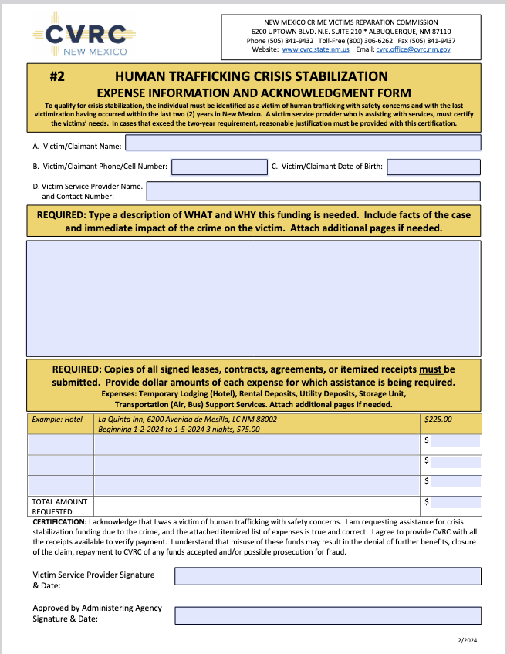
HT Request Form
Submit HT Crisis Stabilization Form with supporting documentation to the administering agency

Slide 16
Missing Person(s) Funds
WHAT: Up to $3000
WHEN: Mon-Fri, 8 a.m. – 5 p.m.
CONTACT: Coalition to Stop Violence Against Native Women 505-243-9199

Slide 17
MPF Allowable Costs
Eligible
Ineligible
Emergency counseling
Travel Expenses
Loss of Wages
Funeral Expenses
Print and digital materials
Other costs as presented
Long term housing, including ongoing rent and utilities.
Expenses related to recovering lost property.
No reward(s)

Slide 18
MPF Request Form
Submit Missing Person(s) Fund Expense Information and Acknowledgement Form with supporting documentation to the administering agency

Slide 19
NMCSAP Emergency Funds
WHAT: For Survivors of Sexual Violence
WHEN: Mon-Fri, 8 a.m. – 5 p.m.
CONTACT: New Mexico Coalition of Sexual Assault Programs 505-883-8020

Slide 20
NMCSAP Request Form
Submit NMCSAP Emergency Funds Request Form with supporting documentation to the coalition

Slide 21
QUESTIONS?

Slide 22
Locate Documents www.cvrc.state.nm.us

Slide 23
www.cvrc.state.nm.us 505-841-9432 Thank you

