Slide 1

New Mexico Crime Victims Reparation Commission

Slide 2
Who is CVRC?
The Crime Victims Reparation Commission (CVRC) assists victims of violent crime with expenses incurred as a result of their victimization.
CVRC also administers funding to organizations to provide victim services statewide.

Slide 3
Purpose of Emergency Funds
This funding is designated to provide victim(s) experiencing health and safety issues related to their victimization with immediate financial assistance.

Slide 4
Types of Emergency Funds
Emergency Assistance Funds
Human Trafficking Crisis Stabilization Funds
Missing Person(s) Funds
New Mexico Coalition of Sexual Assault Programs Emergency Funds

Slide 5
Accessing Emergency Funds
Associated with victimization
Immediate health and safety issue
Initiated by a victim advocate (Do not advise victim to contact administering agencies directly)
Supporting documentation must accompany the request form
Incomplete requests will be deemed ineligible and must be resubmitted as a complete packet

Slide 6
Accessing Emergency Funds
Provide the name and contact information for an alternate point of contact
A compensation application should be completed
Funds are a one-time opportunity
Can not access multiple emergency funds for a single victim
Allow up to 24 hours to process request(s)

Slide 7
Emergency Assistance Funds
WHAT: Up to $3,000*
WHEN: Mon-Fri, 8 a.m. – 5 p.m.
(Depends on Administering Agency)
*Some expenses have financial thresholds.

Slide 8
Emergency Assistance Funds Administering Agencies
Assurance Home, Inc.
Arise Sexual Assault Services
Community Against Violence (CAV)
El Refugio, Inc.
La Pinon Sexual Assault Recovery Services
New Mexico Crime Victims Reparation Commission
Rape Crisis Center of Central New Mexico
Roberta’s Place
Sexual Assault Services of Northwestern New Mexico

Slide 9
Eligible Expenses
Rent/utilities arrears (should be reasonable)
One month rent/utilities/deposit
Windows/door/lock repair/replacement
Emergency shelter/temporary housing/hotel
Emergency food and clothing
ER counseling/medical/prescriptions
Eyeglasses/contacts

Slide 10
Eligible Expenses
Mileage/per diem (transportation)
Vehicle repair (limit of $250)
Towing and impound fees (limit of $500)
Emergency civil legal assistance (Attorney must agree to the one-time fee of $2,000 and follow case through completion)
Crime scene cleanup

Slide 11
Ineligible Expenses
Funeral/burial expenses
Investigation activities
Medical care
Long term housing
Expenses related to recovering lost property
Non-emergency or expenses unrelated to crime

Slide 12
Human Trafficking Crisis Stabilization
WHAT: Up to $3,000
WHEN: Mon-Fri, 8 a.m. – 5 p.m.
EXPENSES: Due to the unique needs of HT victims, please call one of the administering agencies for assistance and guidance.

Slide 13
HT Crisis Stabilization
Administering Agencies
La Pinon Sexual Assault Recovery Services 575-526-3437
New Mexico Dream Center 505-900-3833
New Mexico Immigrant Law Center 505-247-1023
Rape Crisis Center of Central New Mexico 505-266-7711
The Life Link 505-438-0010

Slide 14
Victims of Human Trafficking
Agencies able to verify victims of human trafficking:
Law Enforcement
Medical provider
Mental Health provider
Prosecutors

Slide 15
Missing Person(s) Funds
WHAT: Up to $3,000
WHEN: Mon-Fri, 8 a.m. – 5 p.m.
CONTACT: Coalition to Stop Violence Against Native Women 505-243-9199

Slide 16
MPF Allowable Costs
Eligible
Ineligible
Emergency counseling
Travel Expenses
Loss of Wages
Funeral Expenses
Print and digital materials
Other costs as presented
Long term housing, including ongoing rent and utilities
Expenses related to recovering lost property
No reward(s)

Slide 17
EAF TIPS
Movers/Uhaul
  Driver’s license for driver
  Full coverage insurance required
  Invoice/estimate from company
Rent & Relocation
  Housing assistance form, if applicable
  Lease (offender can not be listed)
  Ledger of arrears
  W9 from landlord
Temporary Shelter
  Length of stay
  Location
  Number and ages of persons
Travel
  Hotel
  Itinerary and estimated cost (include 2-3 options in case dates/times are booked)
  Meals (per diem is $70 or less depending on hours of travel)
  Mileage from departure address to arrival address
  Mode of travel: Flight, train, bus, personal vehicle
  Real ID, driver’s license, passport, or picture ID
Utilities
  Billing statements
  Vehicle payments or insurance is ineligible

Slide 18
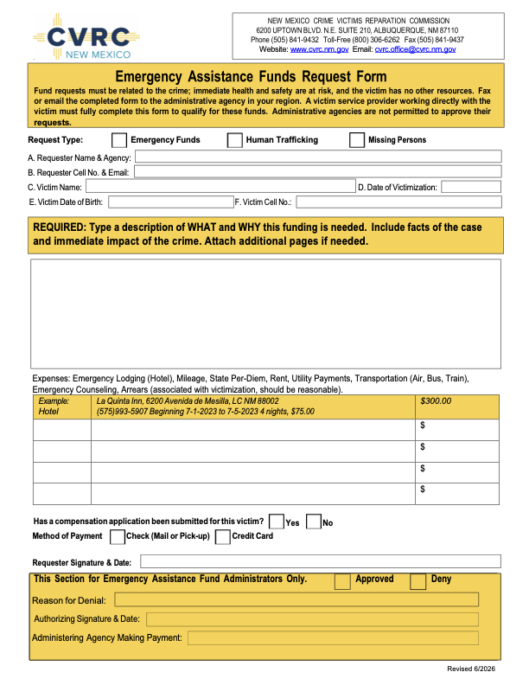
Emergency Assistance Funds Request Form
Submit form with supporting documentation to the administering agency
Make sure to check the appropriate box under Request Type

Slide 19
NMCSAP Emergency Funds
WHAT: For Survivors of Sexual Violence
WHEN: Mon-Fri, 8 a.m. – 5 p.m.
CONTACT: New Mexico Coalition of Sexual Assault Programs 505-883-8020
LIMIT: $1,500

Slide 20
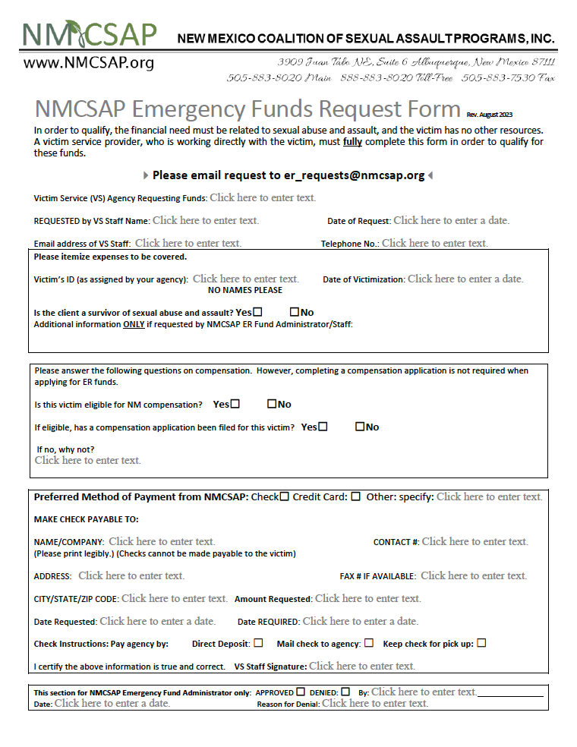
NMCSAP Request Form
Submit NMCSAP Emergency Funds Request Form with supporting documentation to the coalition

Slide 21
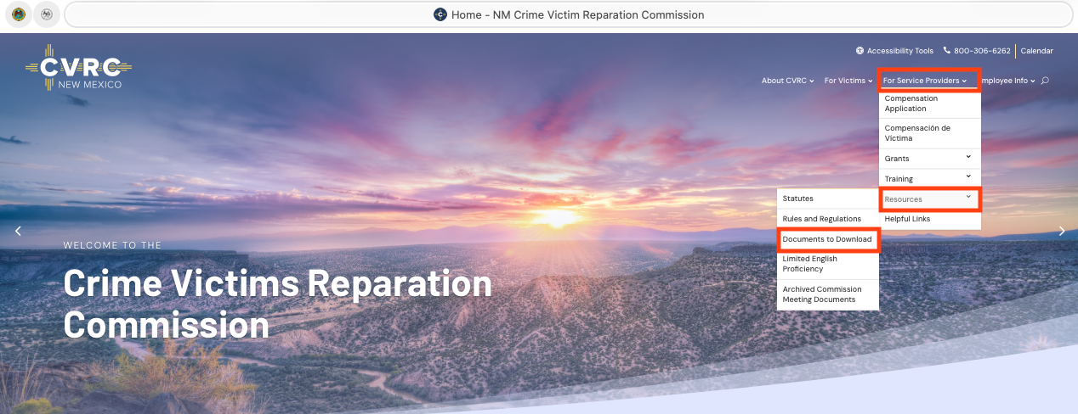

Slide 22
QUESTIONS?

Slide 23
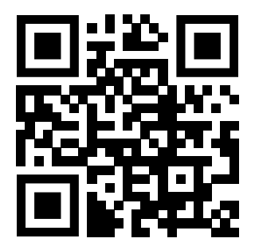
WWW.CVRC.NM.GOV
505-841-9432
Thank you!

